Slide 1


ZOMATO RESTAURANT ANALYSIS
By Pranav Killedar

Slide 2

Introduction :-
In the vibrant tapestry of global gastronomy, Zomato stands as a pioneer, reshaping how people indulge in the world of flavors. A trusted ally to both diners and restaurateurs, our journey has been one of continuous innovation,Zomato has become a trusted partner for both diners and restaurateurs. Today, we unveil a new chapter in our story—a quest for expansion. With a vast network of restaurants and a loyal following, we embark on the exciting mission of opening more restaurants to elevate our platform's offerings.

Slide 3

Problem Statement :-
Zomato, a leading online food delivery and restaurant discovery platform, is seeking to expand its operations and open more restaurants in various regions. As a consultant data analyst, your task is to develop strategies and suggestions for the company's expansion plans.

Slide 4

Objective :-
Geographical Expansion
Diversification of Offerings
Enhanced Customer Engagement
Strategic Partnerships
Operational Efficiency
Market Leadership
Adaptability to Market Trends
Financial Growth

Slide 5
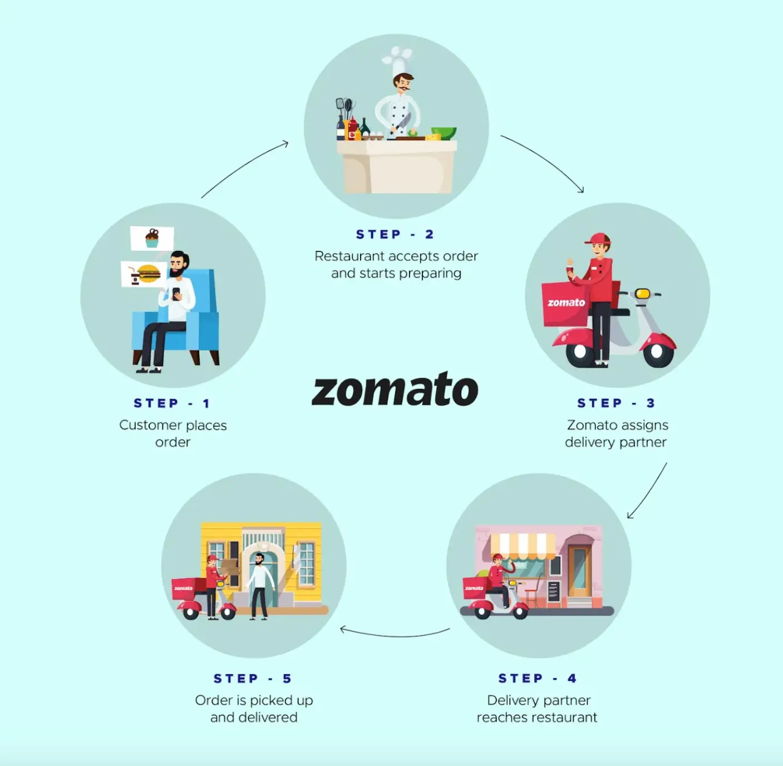
How Zomato Works ?
Step 1: The customer places an order at a restaurant.
Step 2: The restaurant accepts the order and starts preparing the food.
Step 3: Zomato assigns a delivery partner to pick up the food.
Step 4: The delivery partner picks up the food from the restaurant and delivers it to the customer.

Slide 6
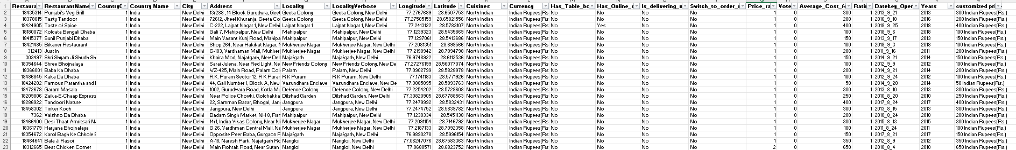
Data Overview :-
The dataset encompasses 20 columns, including essential information such as restaurant ID, country code, longitude, and latitude.
Spans across 15 different countries, showcasing the international presence of Zomato's restaurants.
A grand total of 9,551 restaurants are included in the dataset, offering a comprehensive view of Zomato's global culinary landscape.

Slide 7
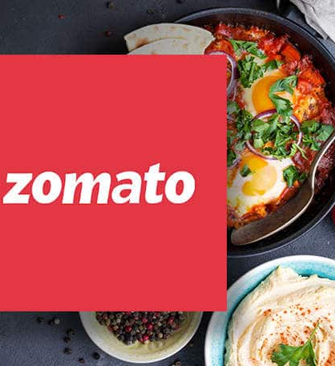
Data Pre-processing
Data Pre-processing Summary:
Country Name Extraction:
Utilized the VLOOKUP function to map country codes to their respective names, enhancing the interpretability of the dataset.
Date Transformation:
Extracted years from the complete date information, providing a clearer temporal dimension for analysis.
Rating Range Grouping:
Employed the GROUP BY function to categorize and group restaurants based on their ratings into meaningful ranges. This allows for a more concise and insightful exploration of the data.

Slide 8
Methodology :-
Data Cleaning: Utilized functions like TRIM, CLEAN, and Remove Duplicates to ensure data accuracy.
Data Enrichment: Enhanced the dataset with additional variables using VLOOKUP to cross-reference external data sources. Also extract the Years from the Date for year wise analysis.
Descriptive Analysis: Created Pivot Tables for summarizing key metrics and identifying different trends and patterns in the restaurants data.
Visualization: Created dynamic charts and dashboards for data representation, enabling interactive data exploration.

Slide 9
Analysis of Zomato Restaurants :-
New restaurant opening ideas:
Here we consider mainly four factors to suggest countries where we can open new restaurants
Count of Restaurants
Ratings of Restaurants
Rating For Online Delivery Availability
Rating For Table Booking Availability

Slide 10
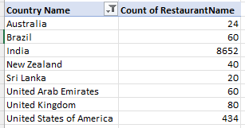
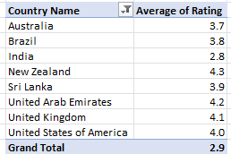
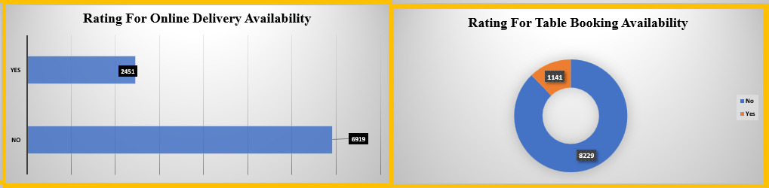
Analysis of Zomato Restaurants :-

Slide 11
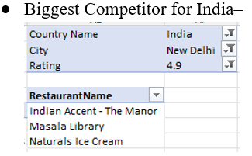
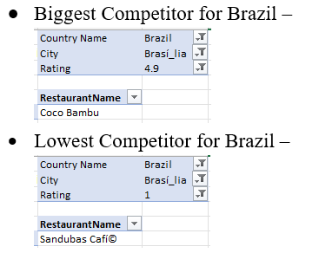
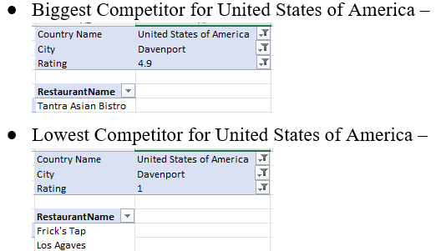
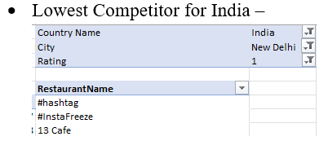
Analysis of Zomato Restaurants :-
Biggest and Lowest Competitors :

Slide 12
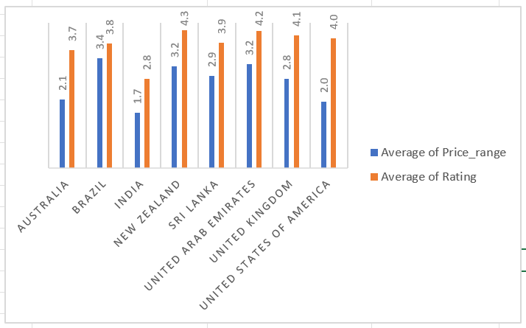
Expenditure vs Ratings Analysis :
Analysis of Zomato Restaurants :-
As per the current calculation if we issue a pivot chart for average price range vs ratings and number of restaurants suggested, we can see that most of them falls between 1.7 to 3.7

Slide 13
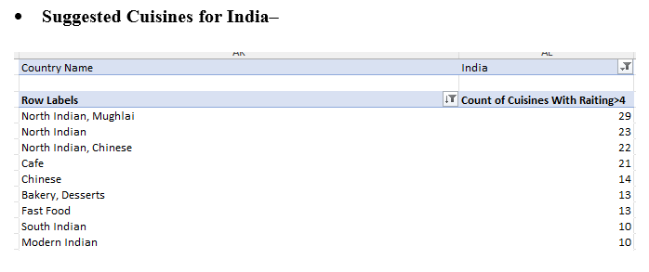
Analysis of Zomato Restaurants :-
Choice of Cuisines based on Ratings>=4 :

Slide 14
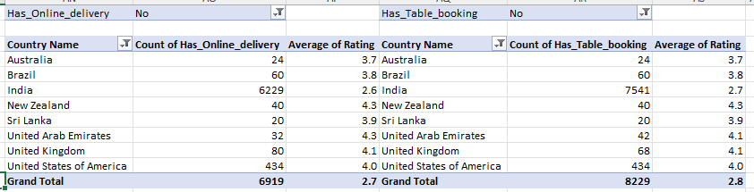
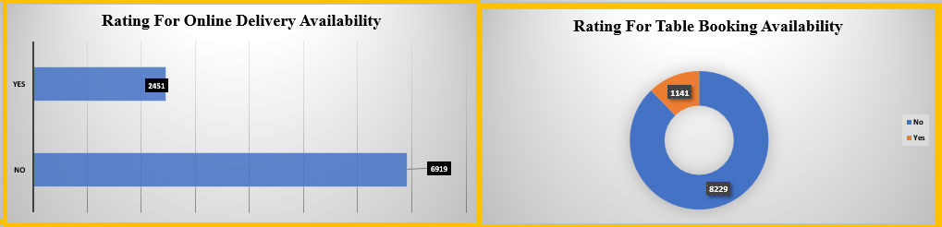
Analysis of Zomato Restaurants :-
Online Delivery and Table Booking :
Here we need to provide Online Delivery and Table Booking to get better response and Ratings

Slide 15
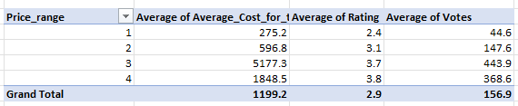
Analysis of Zomato Restaurants :-
Should the team keep the rate of cuisines higher :
Yes, there is a positive correlation between higher rates and better votes and ratings

Slide 16
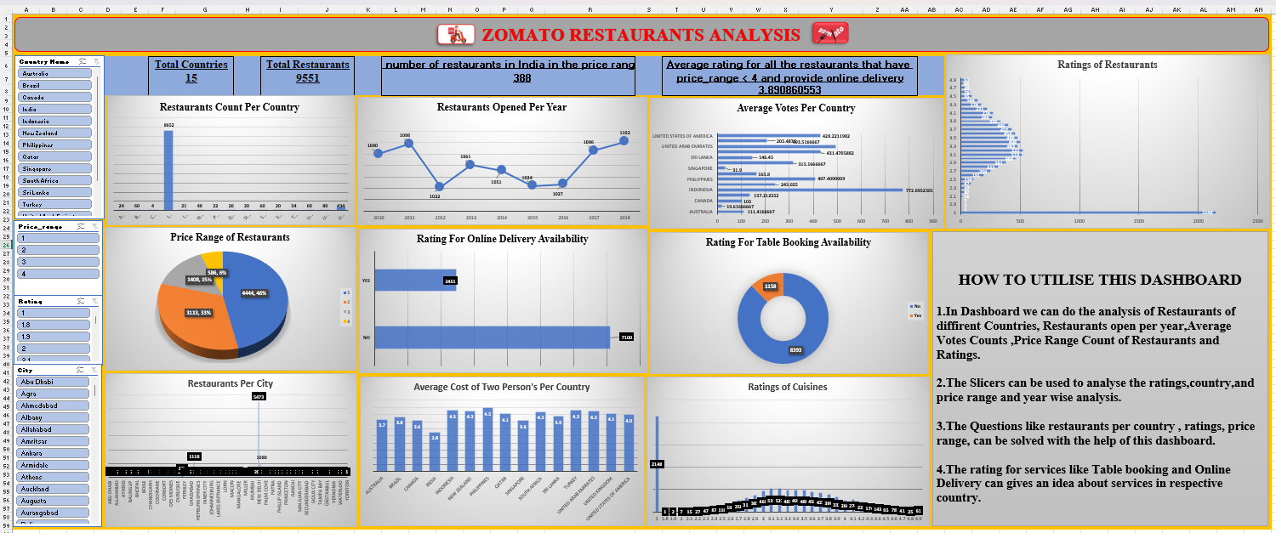
Dashboard and Visualizations :-

Slide 17
Key Visualizations
The dashboard enables users to assess country-wise ratings relative to the number of restaurants available.
Interactive slicers allow users to view the establishment of restaurants year-wise.
Utilizing slicer features, users can explore the average rating of each country directly from the dashboard.
The dropdown menu facilitates the examination of average prices for two, categorized by restaurant and currency, enhancing understanding of pricing dynamics.
The dashboard provides insights into the relationship between pricing and ratings.

Slide 18
Conclusion :-
Holistic Approach: Zomato offers a comprehensive solution for restaurant management.
Streamlined Operations: Manages orders, tracks inventory, and simplifies workflows.
Data-Driven Decisions: Provides insights from customer feedback and sales for informed choices.
Stronger Customer Relationships: Analyzes feedback to improve interactions and foster loyalty.
Empowering Restaurant Owners: Equips them with the tools to optimize their business.
Future of Dining: Zomato exemplifies the positive impact of technology on the restaurant experience.

